Slide 1
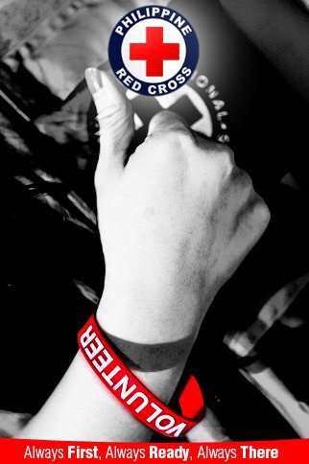

Slide 3
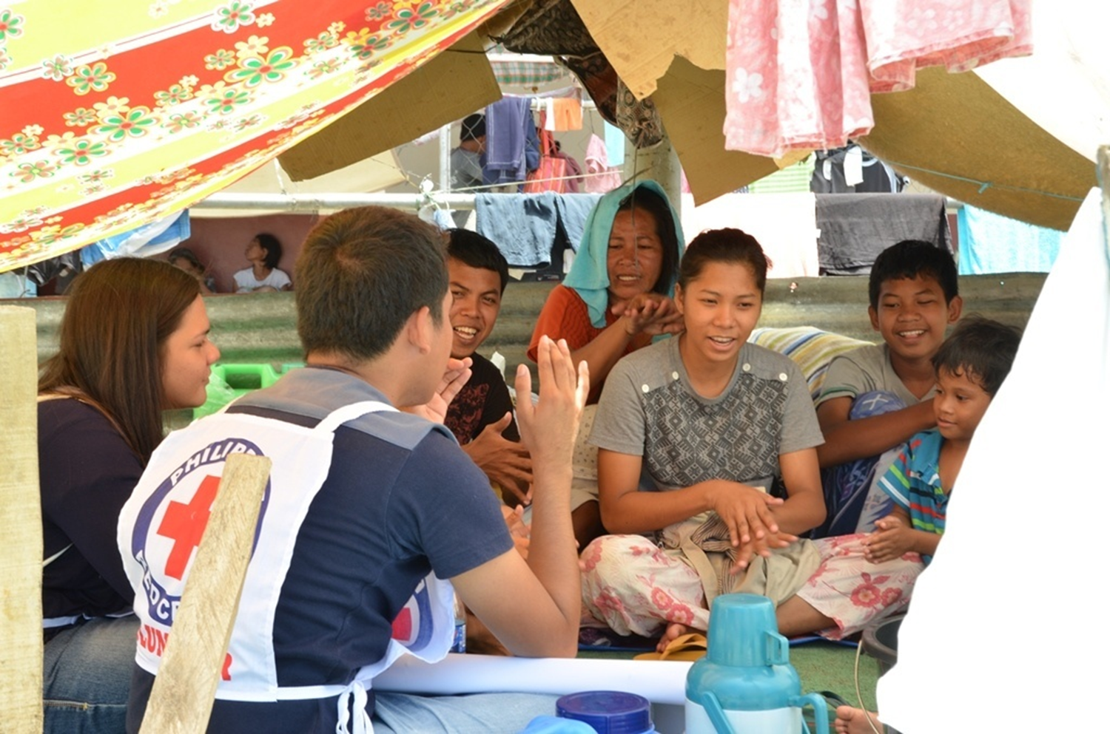
Red Cross 143 Program Goal
To promote a culture of self-help in communities by developing a formidable network of Red Cross volunteers who will respond rapidly and efficiently in emergencies and disasters.
The Philippine National Red Cross

Slide 4
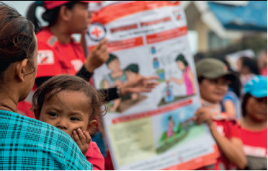
Advantages of Red Cross 143
Risk and damage reduction
Coordinated quick on-site response and assistance
Continuous blood supply
Even in a massive disaster, 143 volunteers can still assist and manage
Facility of tracing and family visits
Development of more resilient communities

Slide 5
Tasks of 44 Volunteers
Disaster Preparedness and Response
Health and Welfare
Walking Blood Bank

Slide 6
Red Cross 143 Objectives
1 leader + 43 members
in every barangay
Creates 44 on-site take charge volunteers
First to Prepare
First to Know
First to Report
First to Respond
First to provide relief, recovery and rehabilitate

Slide 7
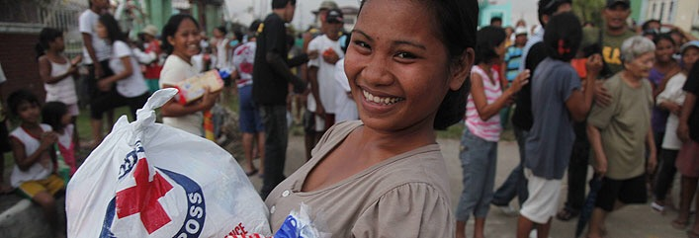
Disaster Preparedness and Response
Hazard Mapping
Risk Reduction
Early Warning
Evacuation Management
First Aid and Rescue
Relief Distribution
Rehabilitation

Slide 8
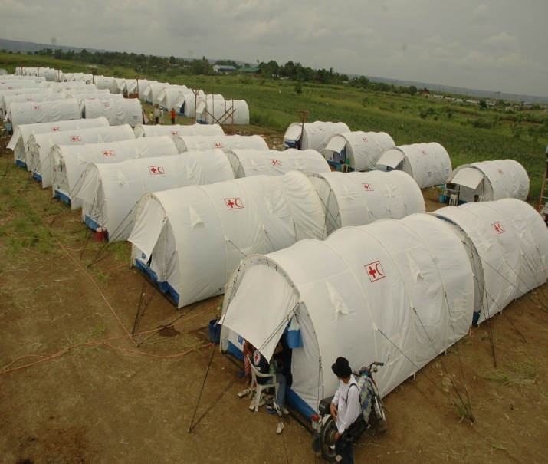
Disaster Response Team
Relief Distribution
First aid / Basic Life Support
Camp / Shelter Management
Evacuation and evacuation center management

Slide 9
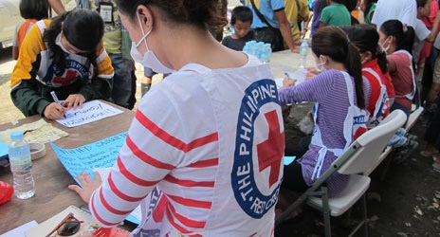
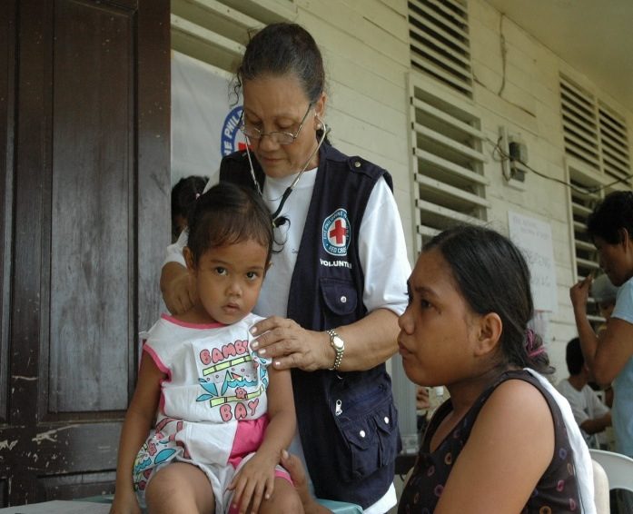
Health and Welfare
Camp Management
Stress Debriefing
Disease Prevention
Isolation of Patient
Hygiene Promotion
Family Support

Slide 10
Health and Welfare Team
Psychosocial support program / critical incident stress debriefing
Health and medical assistance
Water and sanitation
Public health in emergencies and disease prevention education
Livelihood program
Home health care

Slide 11
Volunteer Blood Donors
> Availability of blood and blood products during disaster, disease outbreaks and blood lean month
> Network of volunteer blood donors and recruiters

Slide 13
Red Cross 143 Strategy
“Using Cell Phones / Computers etc., 143 volunteers will:”
Get the disaster report out to the world
Be able to help immediately on the ground
NHQ and IFRC and other 143 units can provide immediate assistance and able to prepare long term relief and rehabilitation

Slide 14
Always READY
(predict, plan,
prepare, practice)
First to
Report, Cope,
Mitigate
First to
Provide Relief
First to
Rehabilitate

Slide 15
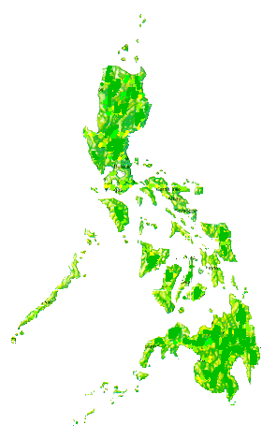
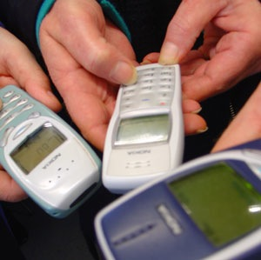
How Does 143 Work?
NHQ Generates National Assistance First
THE PHILIPPINE NATIONAL
RED CROSS
THE PHILIPPINE NATIONAL
RED CROSS
THE PHILIPPINE NATIONAL
RED CROSS
THE PHILIPPINE NATIONAL
RED CROSS
THE PHILIPPINE NATIONAL
RED CROSS
THE PHILIPPINE NATIONAL
RED CROSS
THE PHILIPPINE NATIONAL
RED CROSS
GENEVA
THE PHILIPPINE NATIONAL
RED CROSS
THE PHILIPPINE NATIONAL
RED CROSS
THE PHILIPPINE NATIONAL
RED CROSS
THE PHILIPPINE NATIONAL
RED CROSS
THE PHILIPPINE NATIONAL
RED CROSS
143 Volunteers Texting Information
THE PHILIPPINE NATIONAL
RED CROSS
THE PHILIPPINE NATIONAL
RED CROSS
International Appeal & Assistance in Case of Need
THE PHILIPPINE NATIONAL
RED CROSS
THE PHILIPPINE NATIONAL
RED CROSS
THE PHILIPPINE NATIONAL
RED CROSS
THE PHILIPPINE NATIONAL
RED CROSS
THE PHILIPPINE NATIONAL
RED CROSS
THE PHILIPPINE NATIONAL
RED CROSS
THE PHILIPPINE NATIONAL
RED CROSS
THE PHILIPPINE NATIONAL
RED CROSS
THE PHILIPPINE NATIONAL
RED CROSS

Slide 16
How To Start Organizing?
Provincial
2. Municipal/City
3. Barangay

Slide 17
Red Cross143 in each Barangay
11
11
11
11
= 44

Slide 18
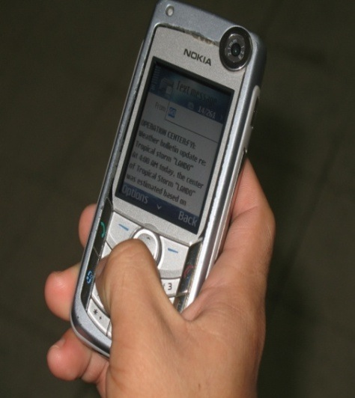
Red Cross 143 Volunteer Tools
Cellular Phone
ID card (Will be placed in NHQ data base, with security code)
Toolkit (What to do & who to call)
Emergency Numbers/ Protocols
Training

Slide 19
Sustainability of Red Cross 143 Program
Constant coordination by Red Cross chapters
Partnership with business sector (i.e., Smart)
Continuous recruitment and training
Constant advocacy for need and motivation
Resource generation and fund raising within the barangays
Neighborhood to support equipage, i.e. response gear
Provision of uniforms, collaterals, etc.
Regular competition of skills and capabilities
Recognition of organization and performance by NHQ and tri-media

Slide 20
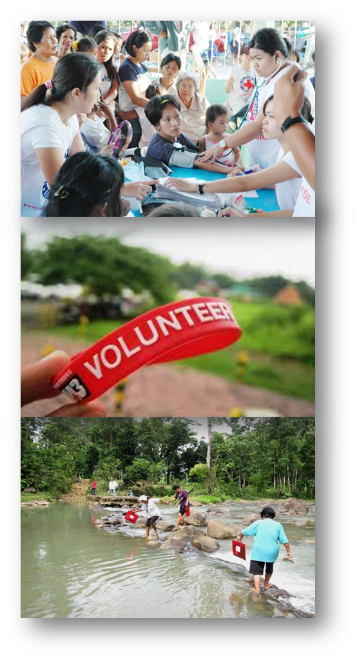
Recruitment
General Qualifications:
+ At least 18 years old
+ Willingness to render volunteer service
+ Physically and mentally fit
+ Good communication skills
+ Active community member
+ Preferably can mobilize resources
The Philippine National Red Cross

Slide 21
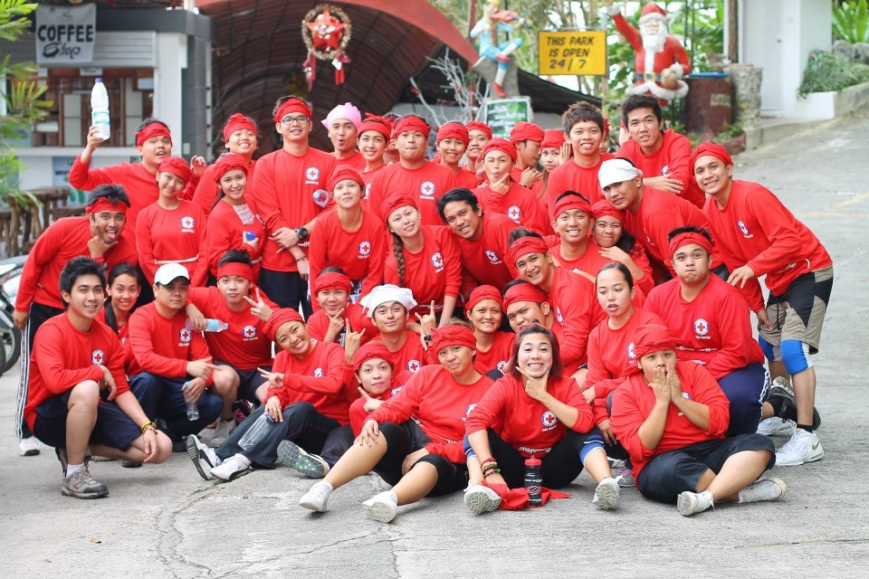
Orientation
After a series of lectures, the new recruits are expected to know the:
+ History and principles of the Movement
+ PRC vision, mission, goals and core values
+ Services of the PRC
+ Roles and responsibilities of volunteers
The Philippine National Red Cross

Slide 22
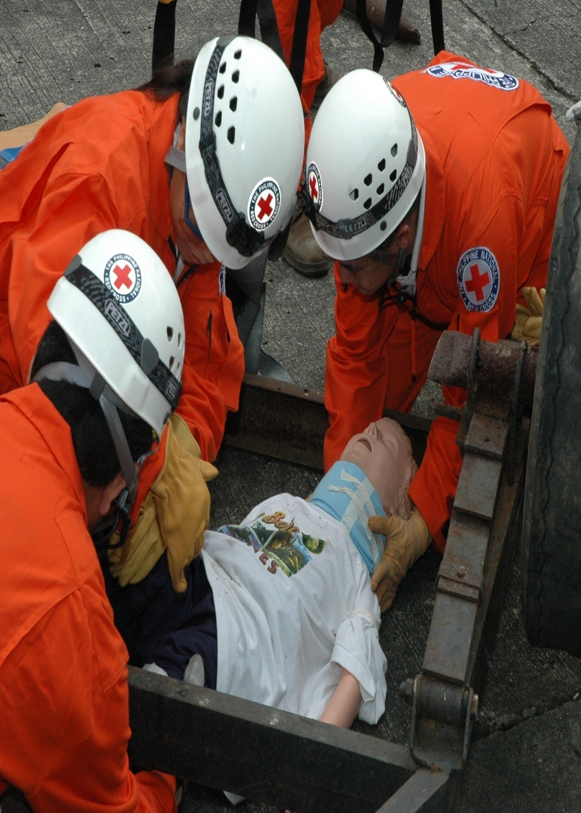
Training
+ Basic First Aid and Life Support
+ Roles and responsibilities
+ Preparedness, prevention and
mitigation
+ Disaster Management course
+ Data gathering and assessment
+ Counter-disaster planning
The Philippine National Red Cross

